Slide 1
LECTURE 14
TOEIC SPEAKING
QUESTIONS 7 – 9
RESPOND TO QUESTIONS
USING INFORMATION PROVIDED

Slide 2
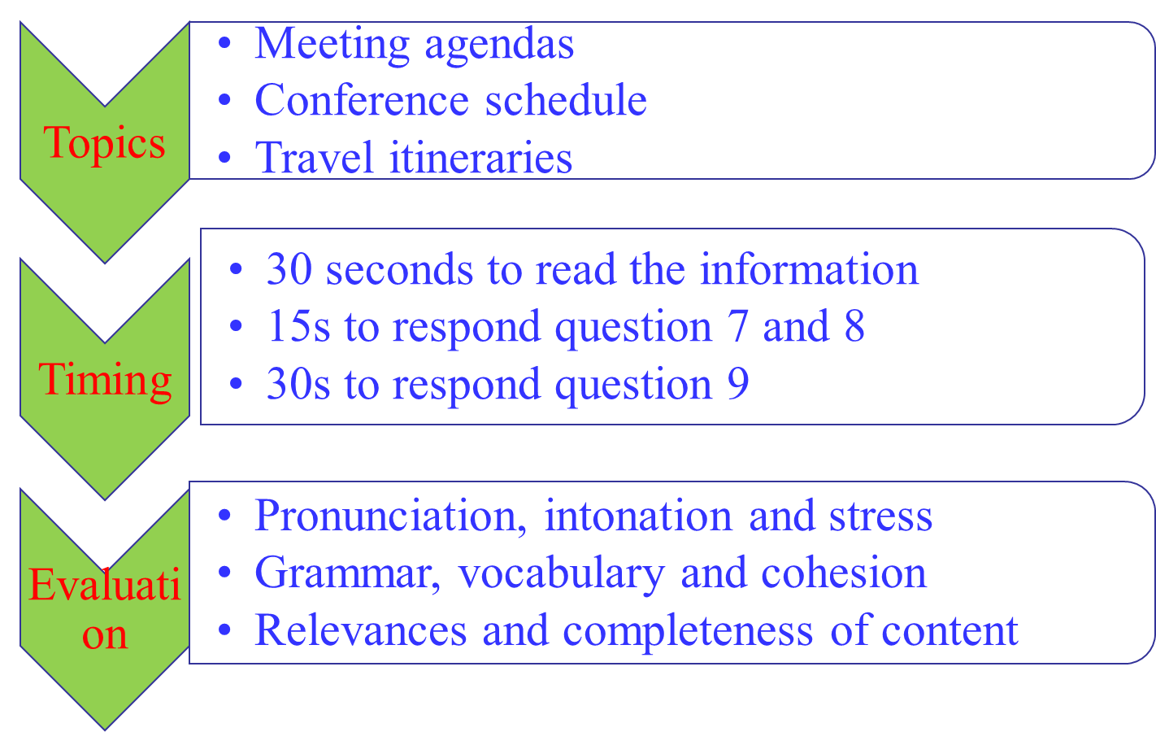
AN OVERVIEW

Slide 3
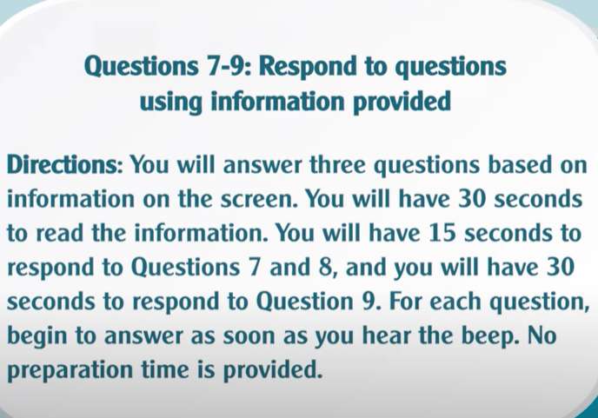
For questions 7-9, you will see the directions and a schedule or an agenda. Read the directions and sample schedule below. What is the schedule for? What activities does it include?

Slide 4
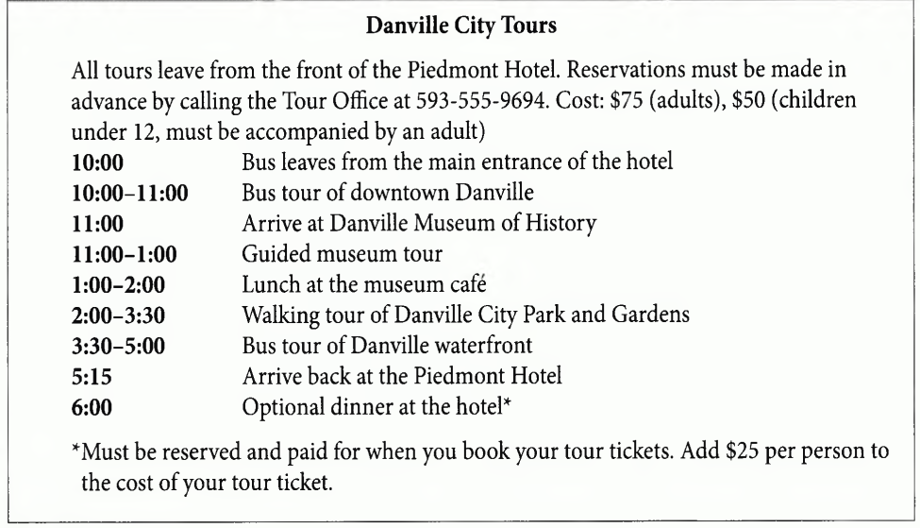

You will hear three questions from the caller. Listen and take note what you hear

Slide 5
Use the questions in your note to give the correct response

Slide 6
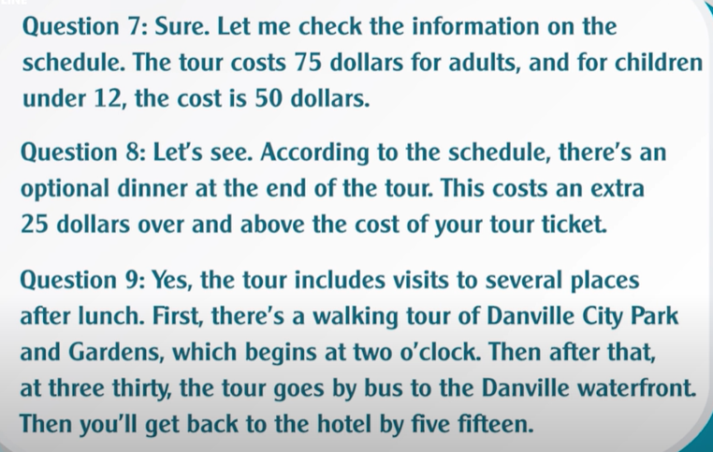

Slide 7
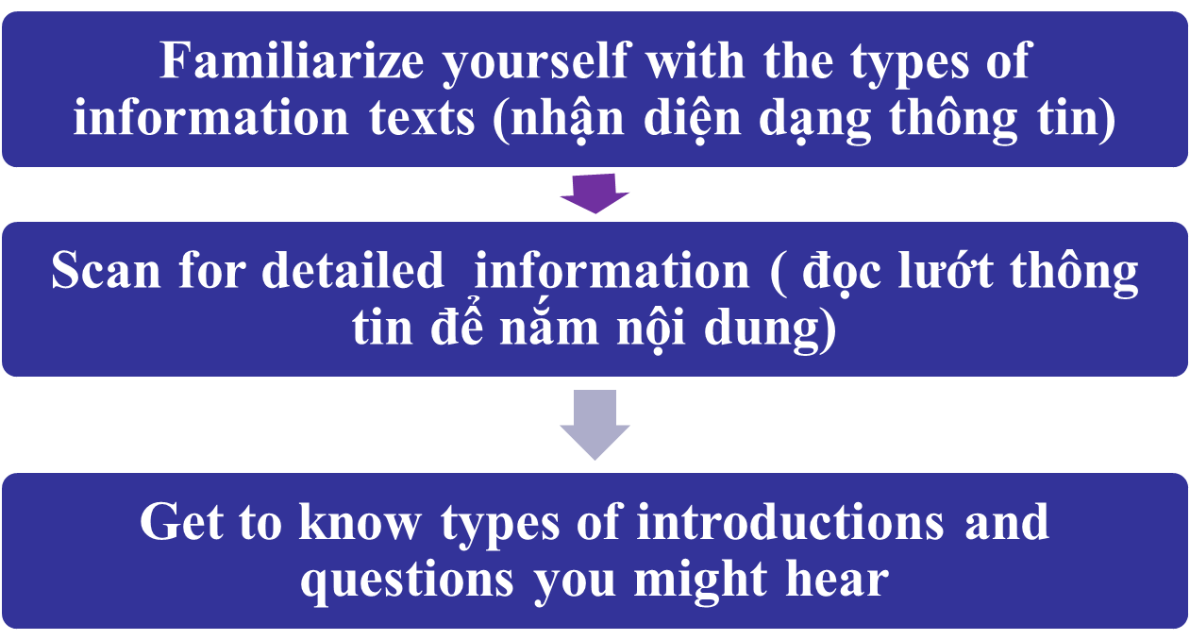
3. TIPS FOR QUESTIONS 7-9
TIP 1
TIP 2
TIP 3

Slide 8
TIP 1: Familiarize yourself with the types of information texts
Task 1. Read the definitions of text types below, then write the number of the correct information text example in TIP 1 next to each text type.
An itinerary is a plan for a trip, including the travel and hotel arrangements and the places that will be visited. …………
An announcement, invitation, or advertisement gives details about an event. ……….
Schedule or agenda is a list of things that will happen and when. ………..

Slide 9
TIP 2: Scan for detailed information
TASK 2. Look at the three information texts in TIP 1. What is the main focus of each text? Circle the correct focus.
Text 1: a conference schedule/ a self- guided tour/ a tour of a work site
Text 2: a gathering of professional writers/ a party for a publisher/ an exhibition of books
Text 3: a meeting at Government Center/ a presentation schedule/ travel plans for a speaker

Slide 10
TASK. LOOK AT THE INFORMATION TEXTS IN TIP 1 & ANSWER THE QUESTIONS BELOW

Slide 11
TIP 3: Get to know types of introductions and questions you might hear
- You will usually hear a short introductory statement by the caller before you hear the questions. This often gives general information about the situation. As you listen to the statement, think about the types of related information that the caller might ask for. After that, you will hear the first question.

Slide 12
- There are several types of questions you might hear, but the most important thing to do is listen for the key words. These tell you the main information to find so you can scan the information text in more detail. Remember, you will only hear the questions— you will not see them on-screen. Therefore, it is important to listen carefully and not get distracted by looking at the information text! Here are some common question types you may hear.

Slide 13
Question Types | Examples
Information Questions | • When does the flight arrive? • I ’m getting in late. W ho’s picking me up? • Where are we having lunch?
Yes-No Questions | • Can I get an earlier train? • Are there any fees involved? •I’d like to stay with friends. Do we have to stay at the hotel? • Will we have a break for coffee?

Slide 14
Question Types | Examples
Embedded Questions | • Could you please let me know what time it starts? • I’d like to meet other attendees. Do you have any idea what there is to do in the evenings? • Would you be able to tell me if there are any seats left?
Tag Questions | • There are supposed to be speakers all day long, aren’t there? • There won’t be a problem with coming early, will there?

Slide 15
TIP 4: IDENTITY THE QUESTION TYPES
(nhận diện dạng câu hỏi)
1. Questions about place
+ Where is the seminar going to be held?
+ Where does the meeting take place?
+ Where will Mr. David leave for?
Using preposition of place “ in/ at/ by”
The meeting will be held at the Fire building in Room B

Slide 16
2. Questions about time (Time/ day/ date/ year)
When does the seminar/ tour/event start?
When should I be there?
What time is the opening speech taking place?
How long will the presentation last?
Preposition of time in/on/at/by
It starts at 7 a.m.
You should be there by seven this morning.
The meeting will take place on 9th September.

Slide 17
3. Questions about people
Who is the key note speaker?
Who will deliver the opening speech?
Mr. David will be in charge of / responsible for delivering speech.
4. Question about price
How much is the ticket?
What does the package tour cost?
What is the price of the tour?
It is $20 for adult.
The tour costs $150
The price of the package tour is $530

Slide 18
5. Yes/ no questions
 Don’t respond Yes/ no only. Remember to give a full answer politely and gently to show your interests.
I heard that the CEO will the opening speech, is that right?
Is the speech at 2 given by Mr. Jack?
Is the tour of the company/s facilities available on weekends?
Is lunch included in the ticket?

Slide 19
NOTES

Slide 20
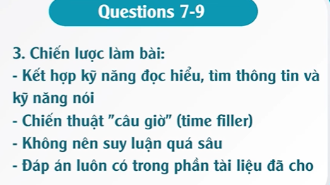

Slide 21
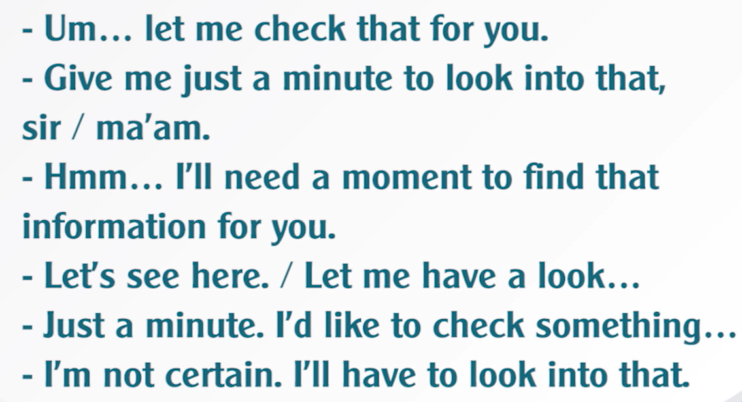
TIME FILLERS

Slide 22
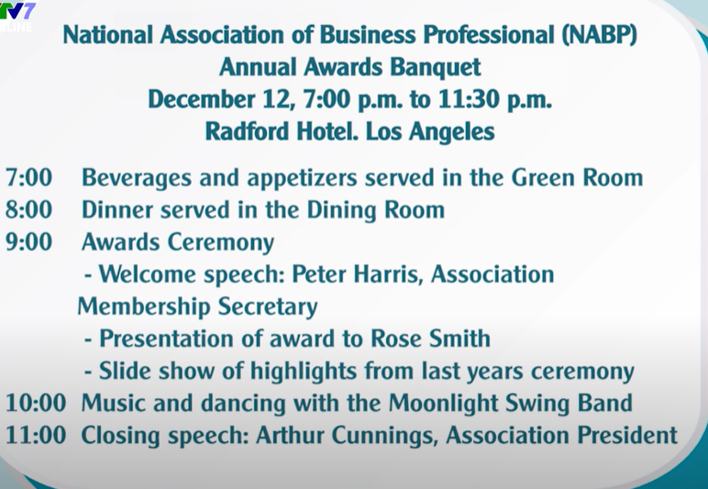
SAMPLE TEST

Slide 23
Answer Analysis: All of these answers are long enough to demonstrate fluency. They make use of words and expressions like Let me check, In fact, It looks like, and so on to give the speaker time to think while formulating an answer. The grammar and vocabulary are appropriate, and the information is correct.

